Slide 1
Summary of the 1st and 2nd experiments for HTT splicing modulation compounds
Oct-21-2022
Zhen, Dann, Catherine, Joon, Magnus, Jessica

Slide 2
Sample similarity from Gene Expression (1st batch)
PCA in 2D for iPSC
PCA in 2D for NGN2

Slide 3
Sample similarity from Gene Expression (2nd batch raw)
PCA in 2D for iPSC
PCA in 2D for NGN2

Slide 4
Sample similarity from Gene Expression (2nd batch raw after removal of low-quality samples)
PCA in 2D for iPSC
PCA in 2D for NGN2

Slide 5
Sample similarity from Gene Expression (2nd batch raw after removal of R4)
PCA in 2D for iPSC
PCA in 2D for NGN2

Slide 6
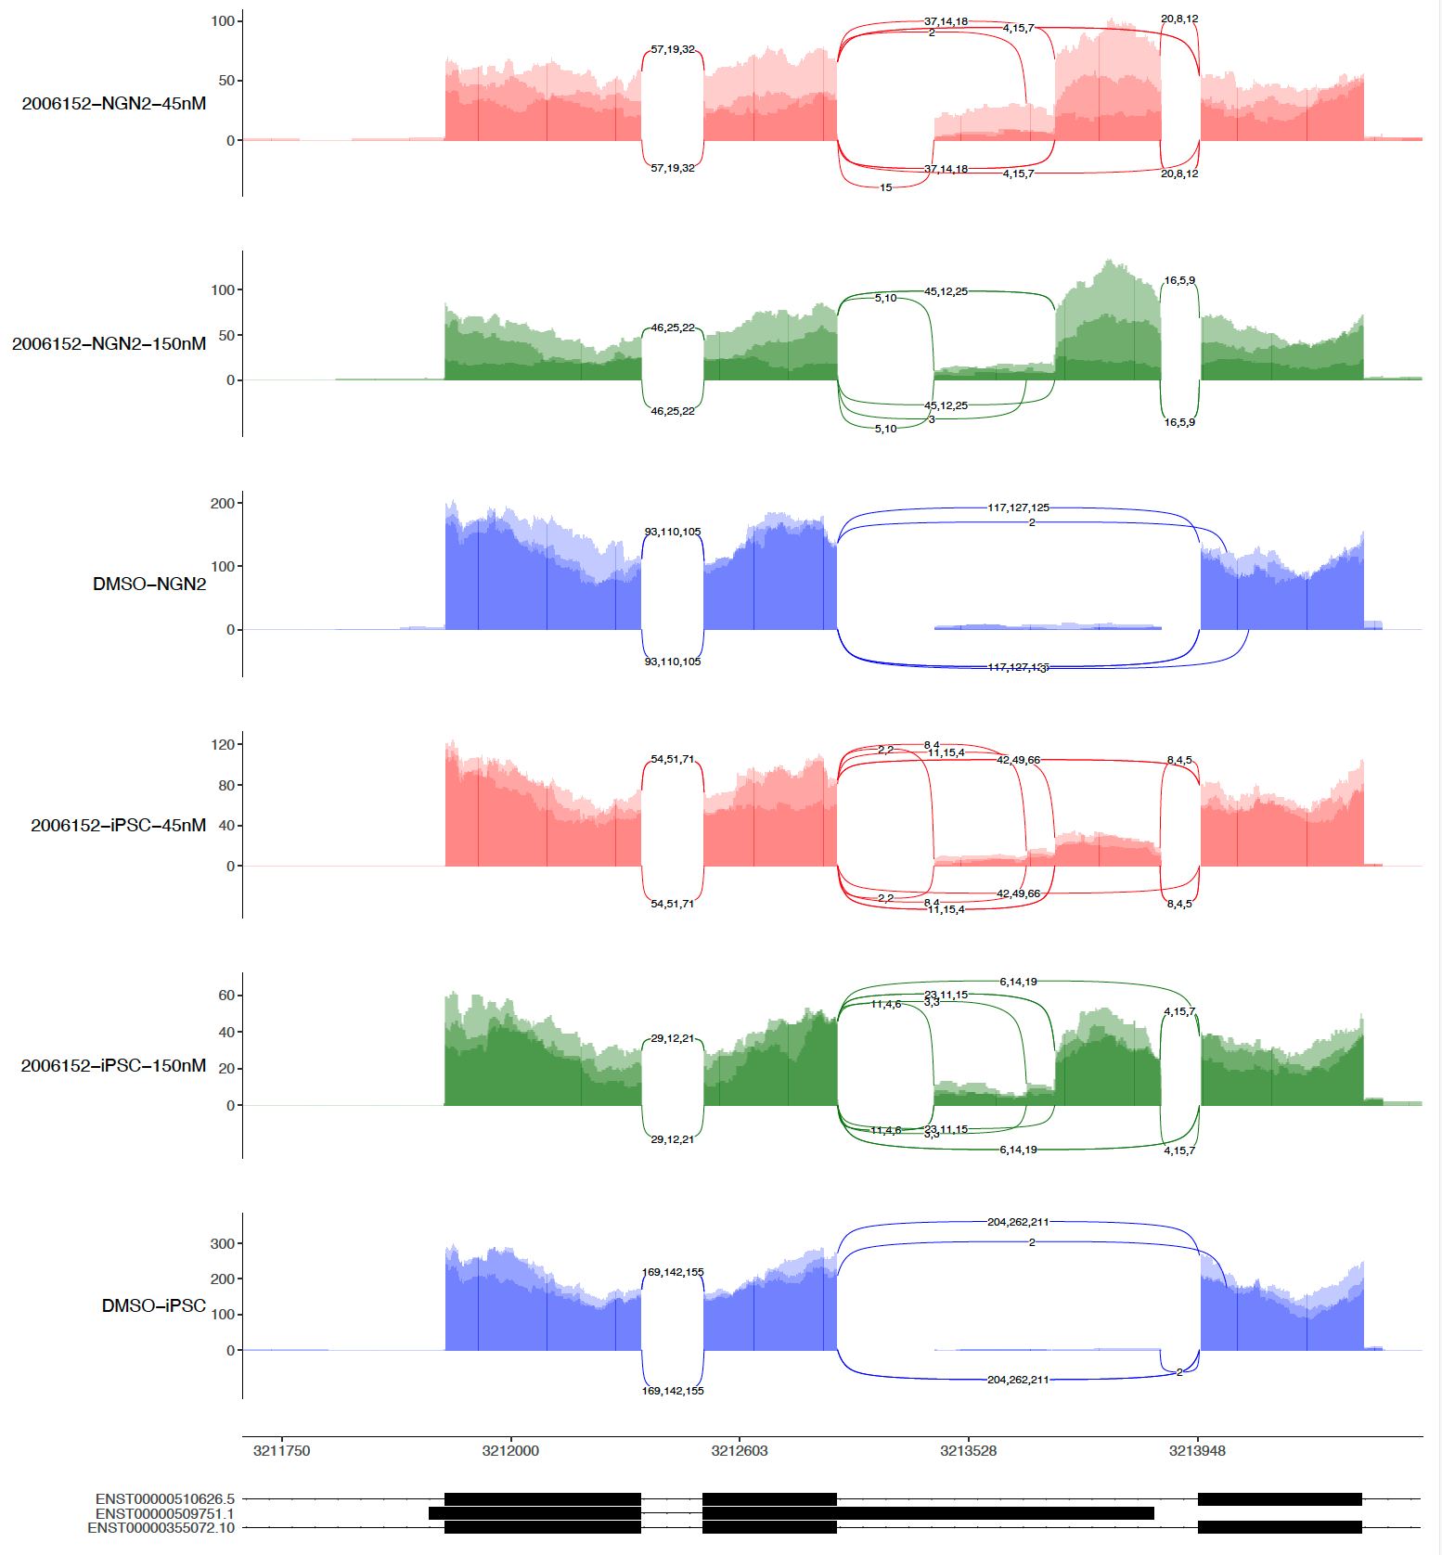
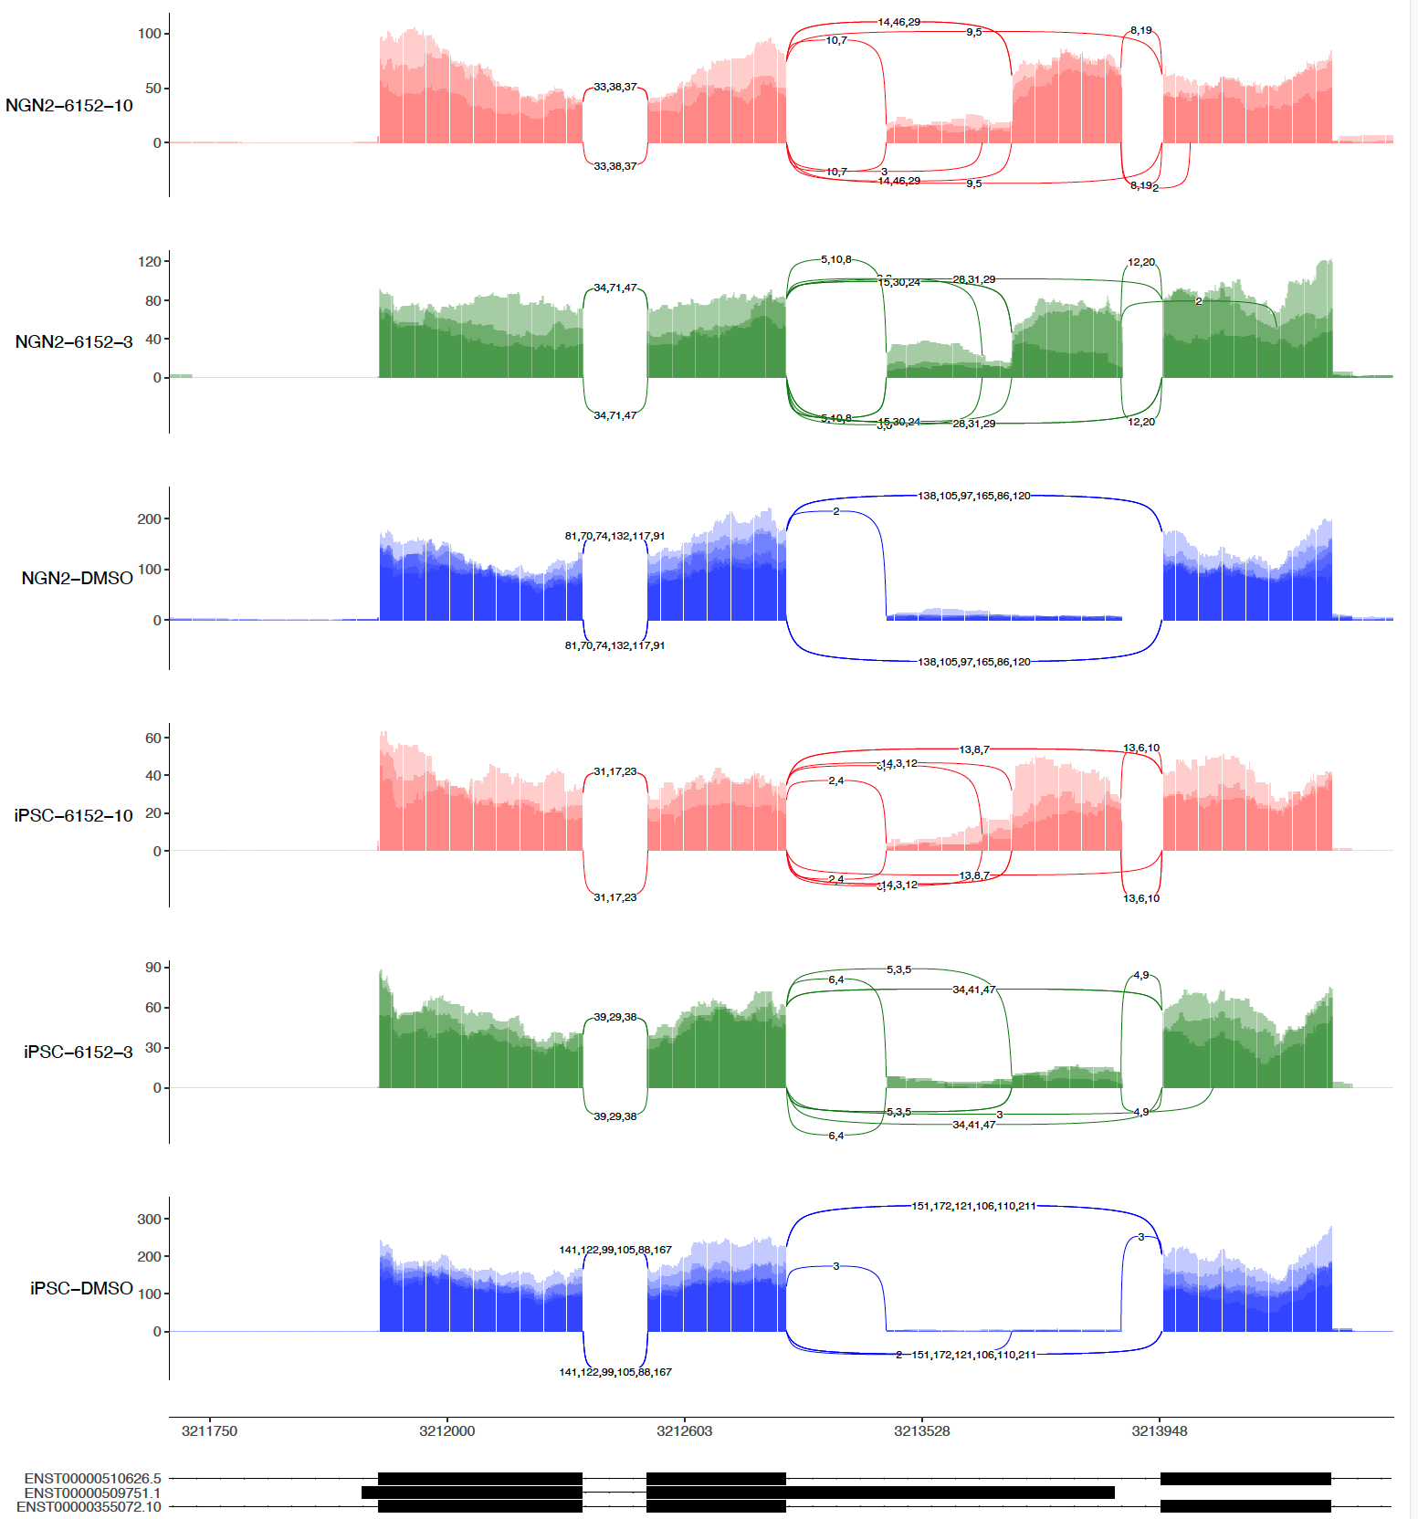
sashimi-plots: 1st 6152 and 2nd 6152

Slide 7
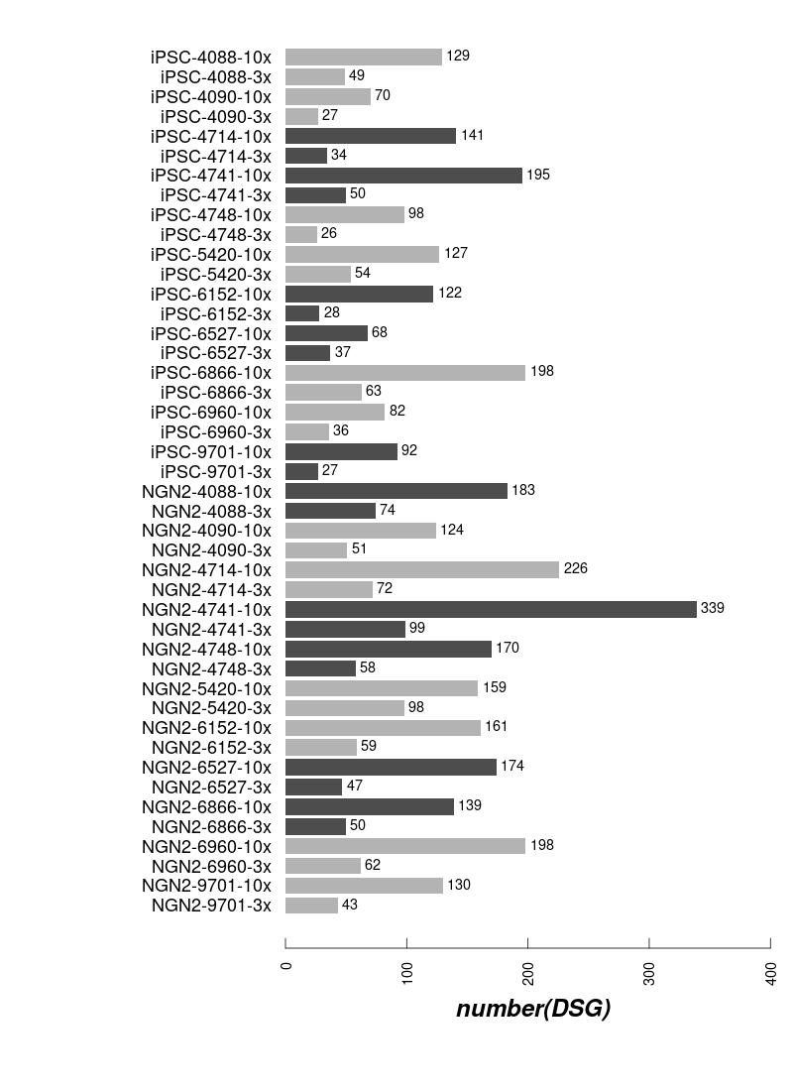
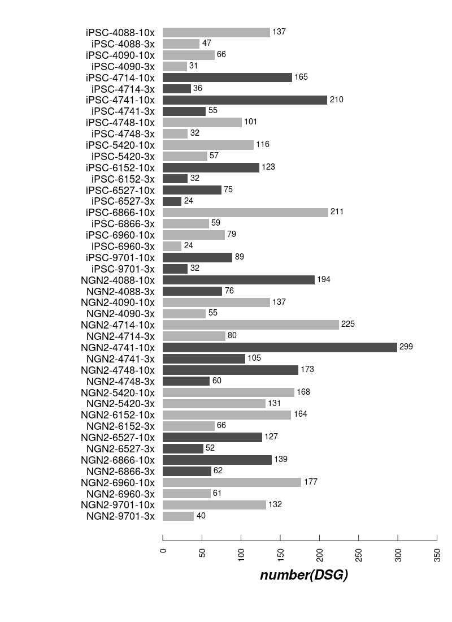
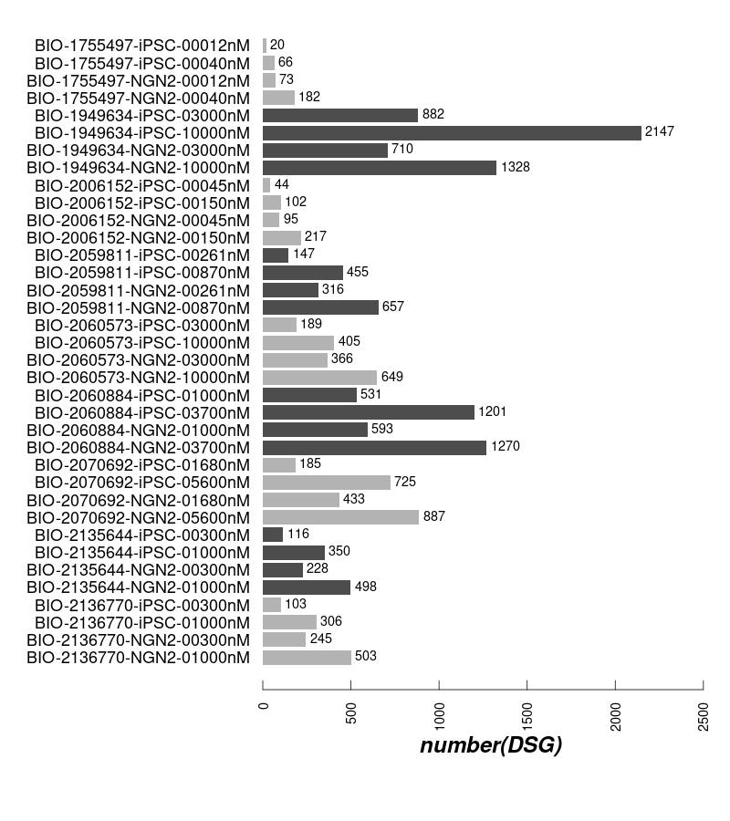
DSG: 1st batch and 2nd batch
1st batch
2nd batch with R4 (4vs8 Ctrl)
2nd batch WO R4 (3vs3 Ctrl)

Slide 8
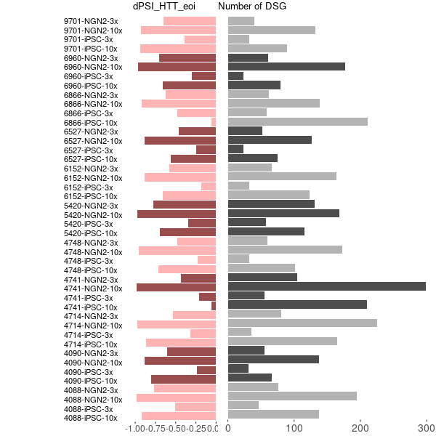
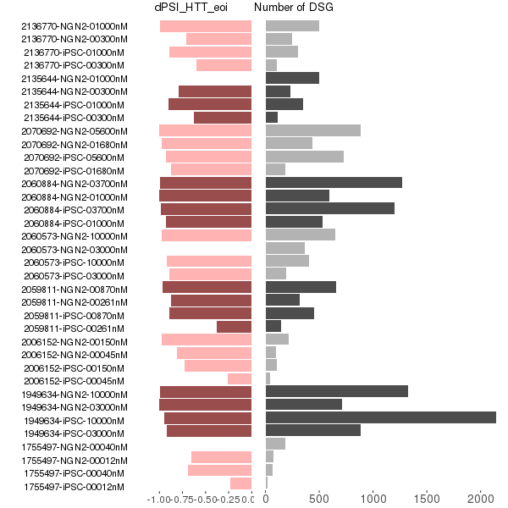
DSG and dPSI in eoi
(1st ext) (2nd exp.)
(leafcutter majiq merged)

Slide 9
DSG repeatability among 1st and 2nd experiments is good

Slide 10
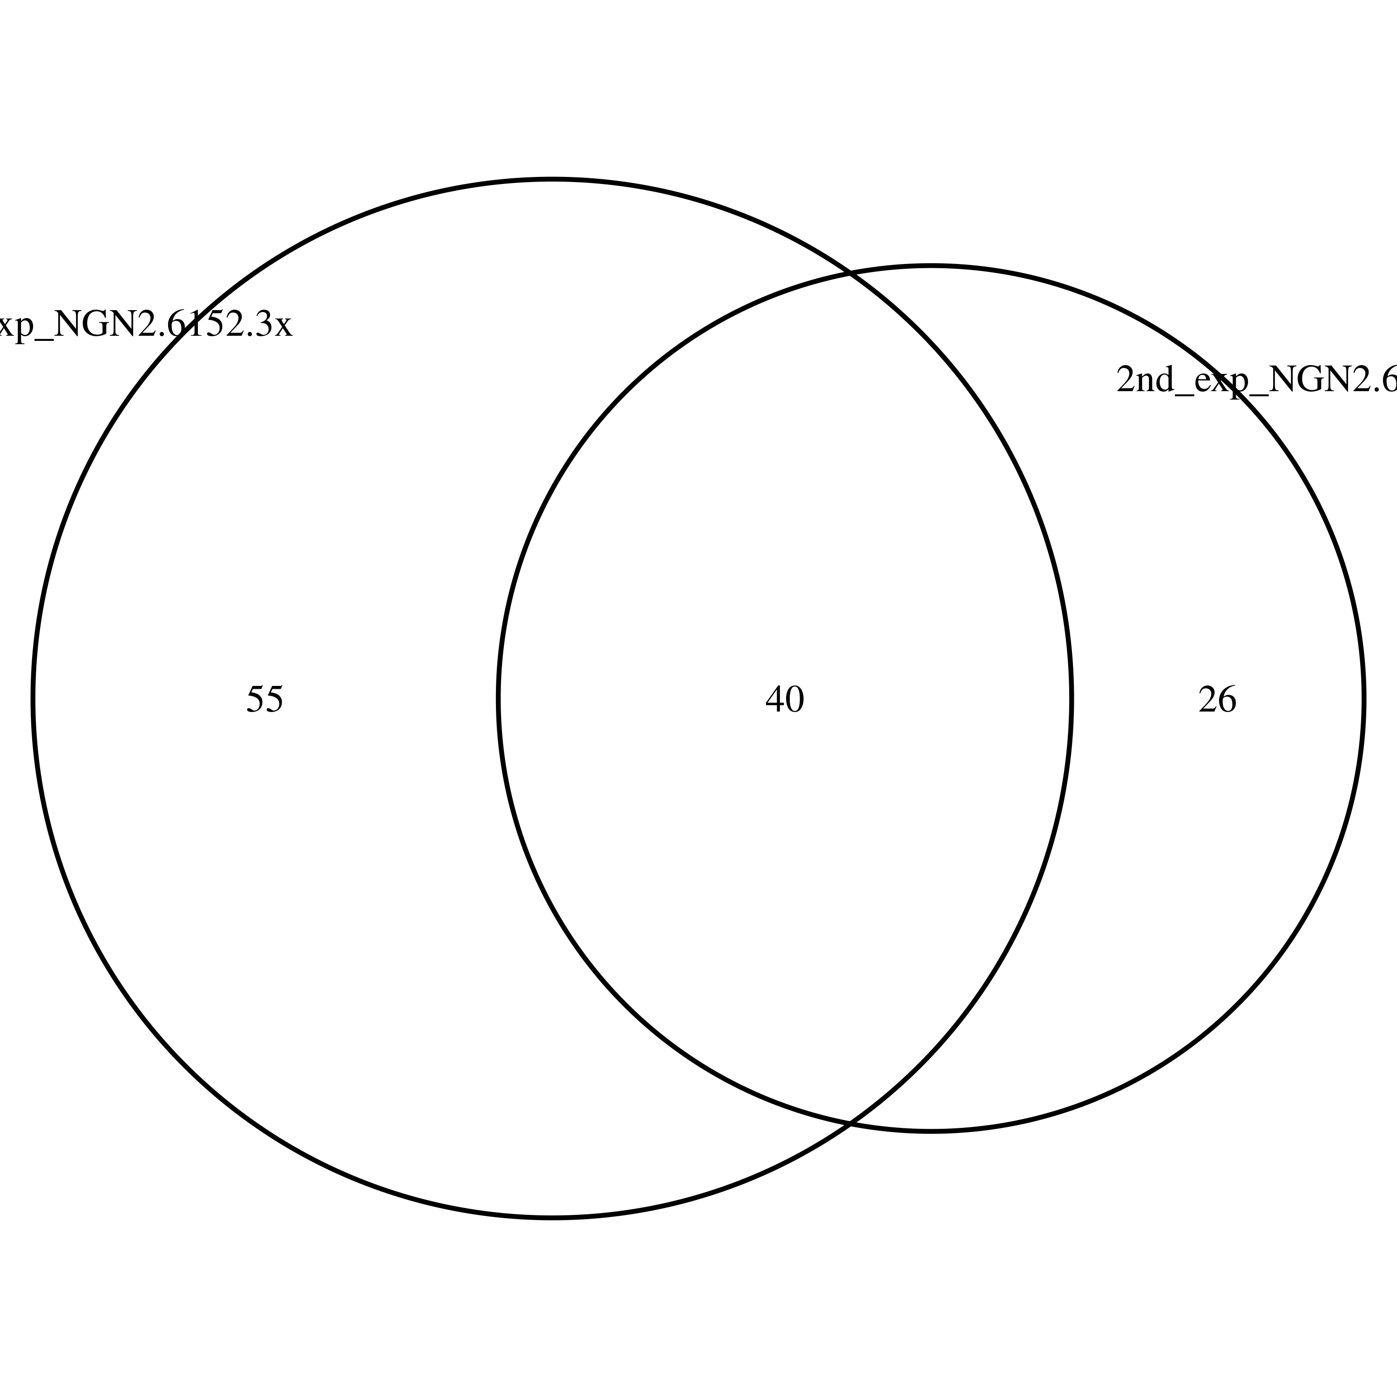
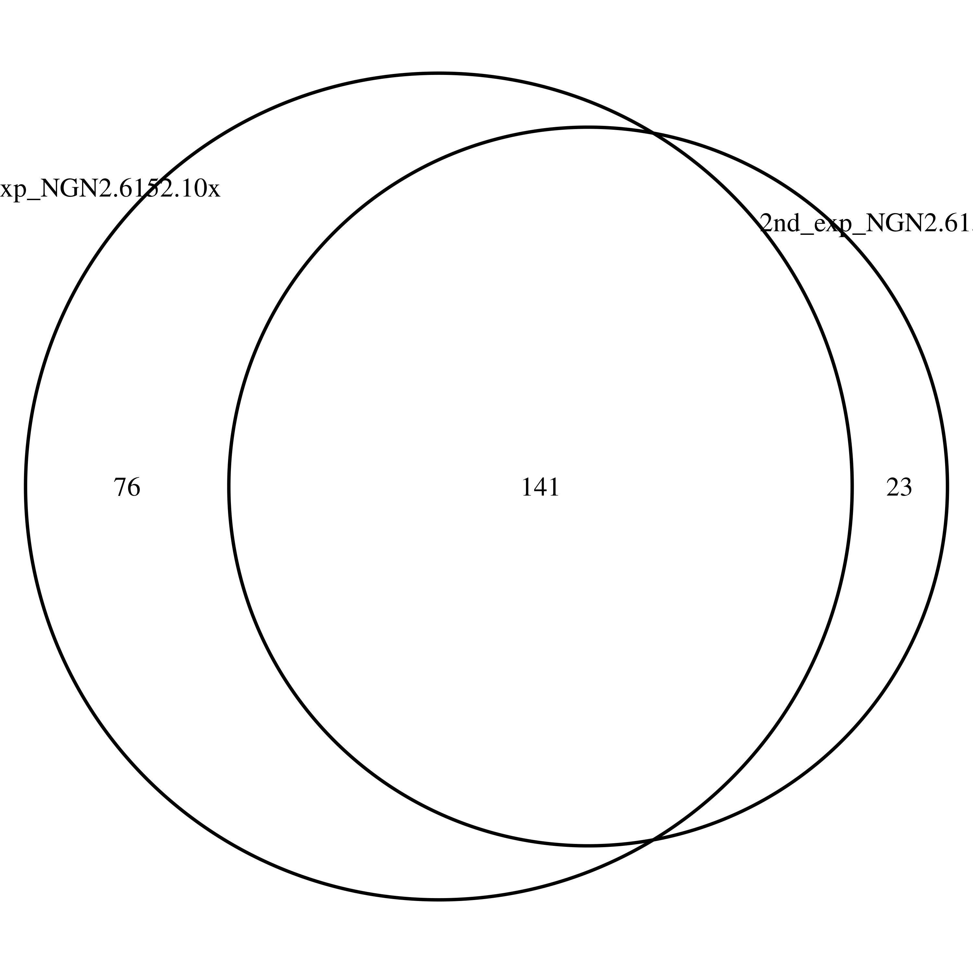
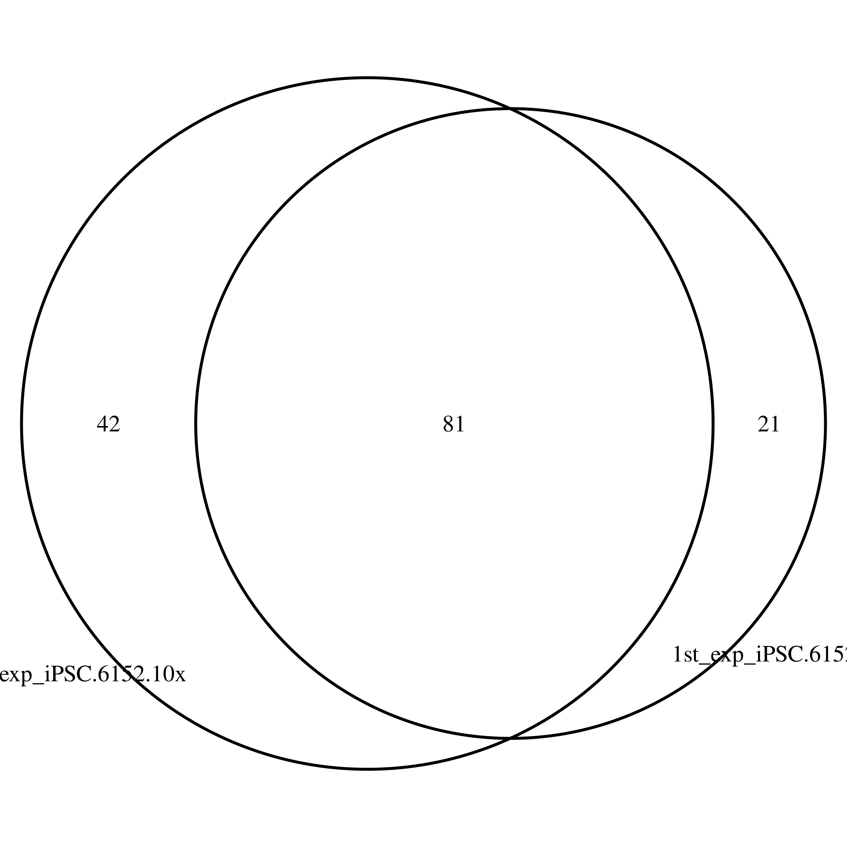
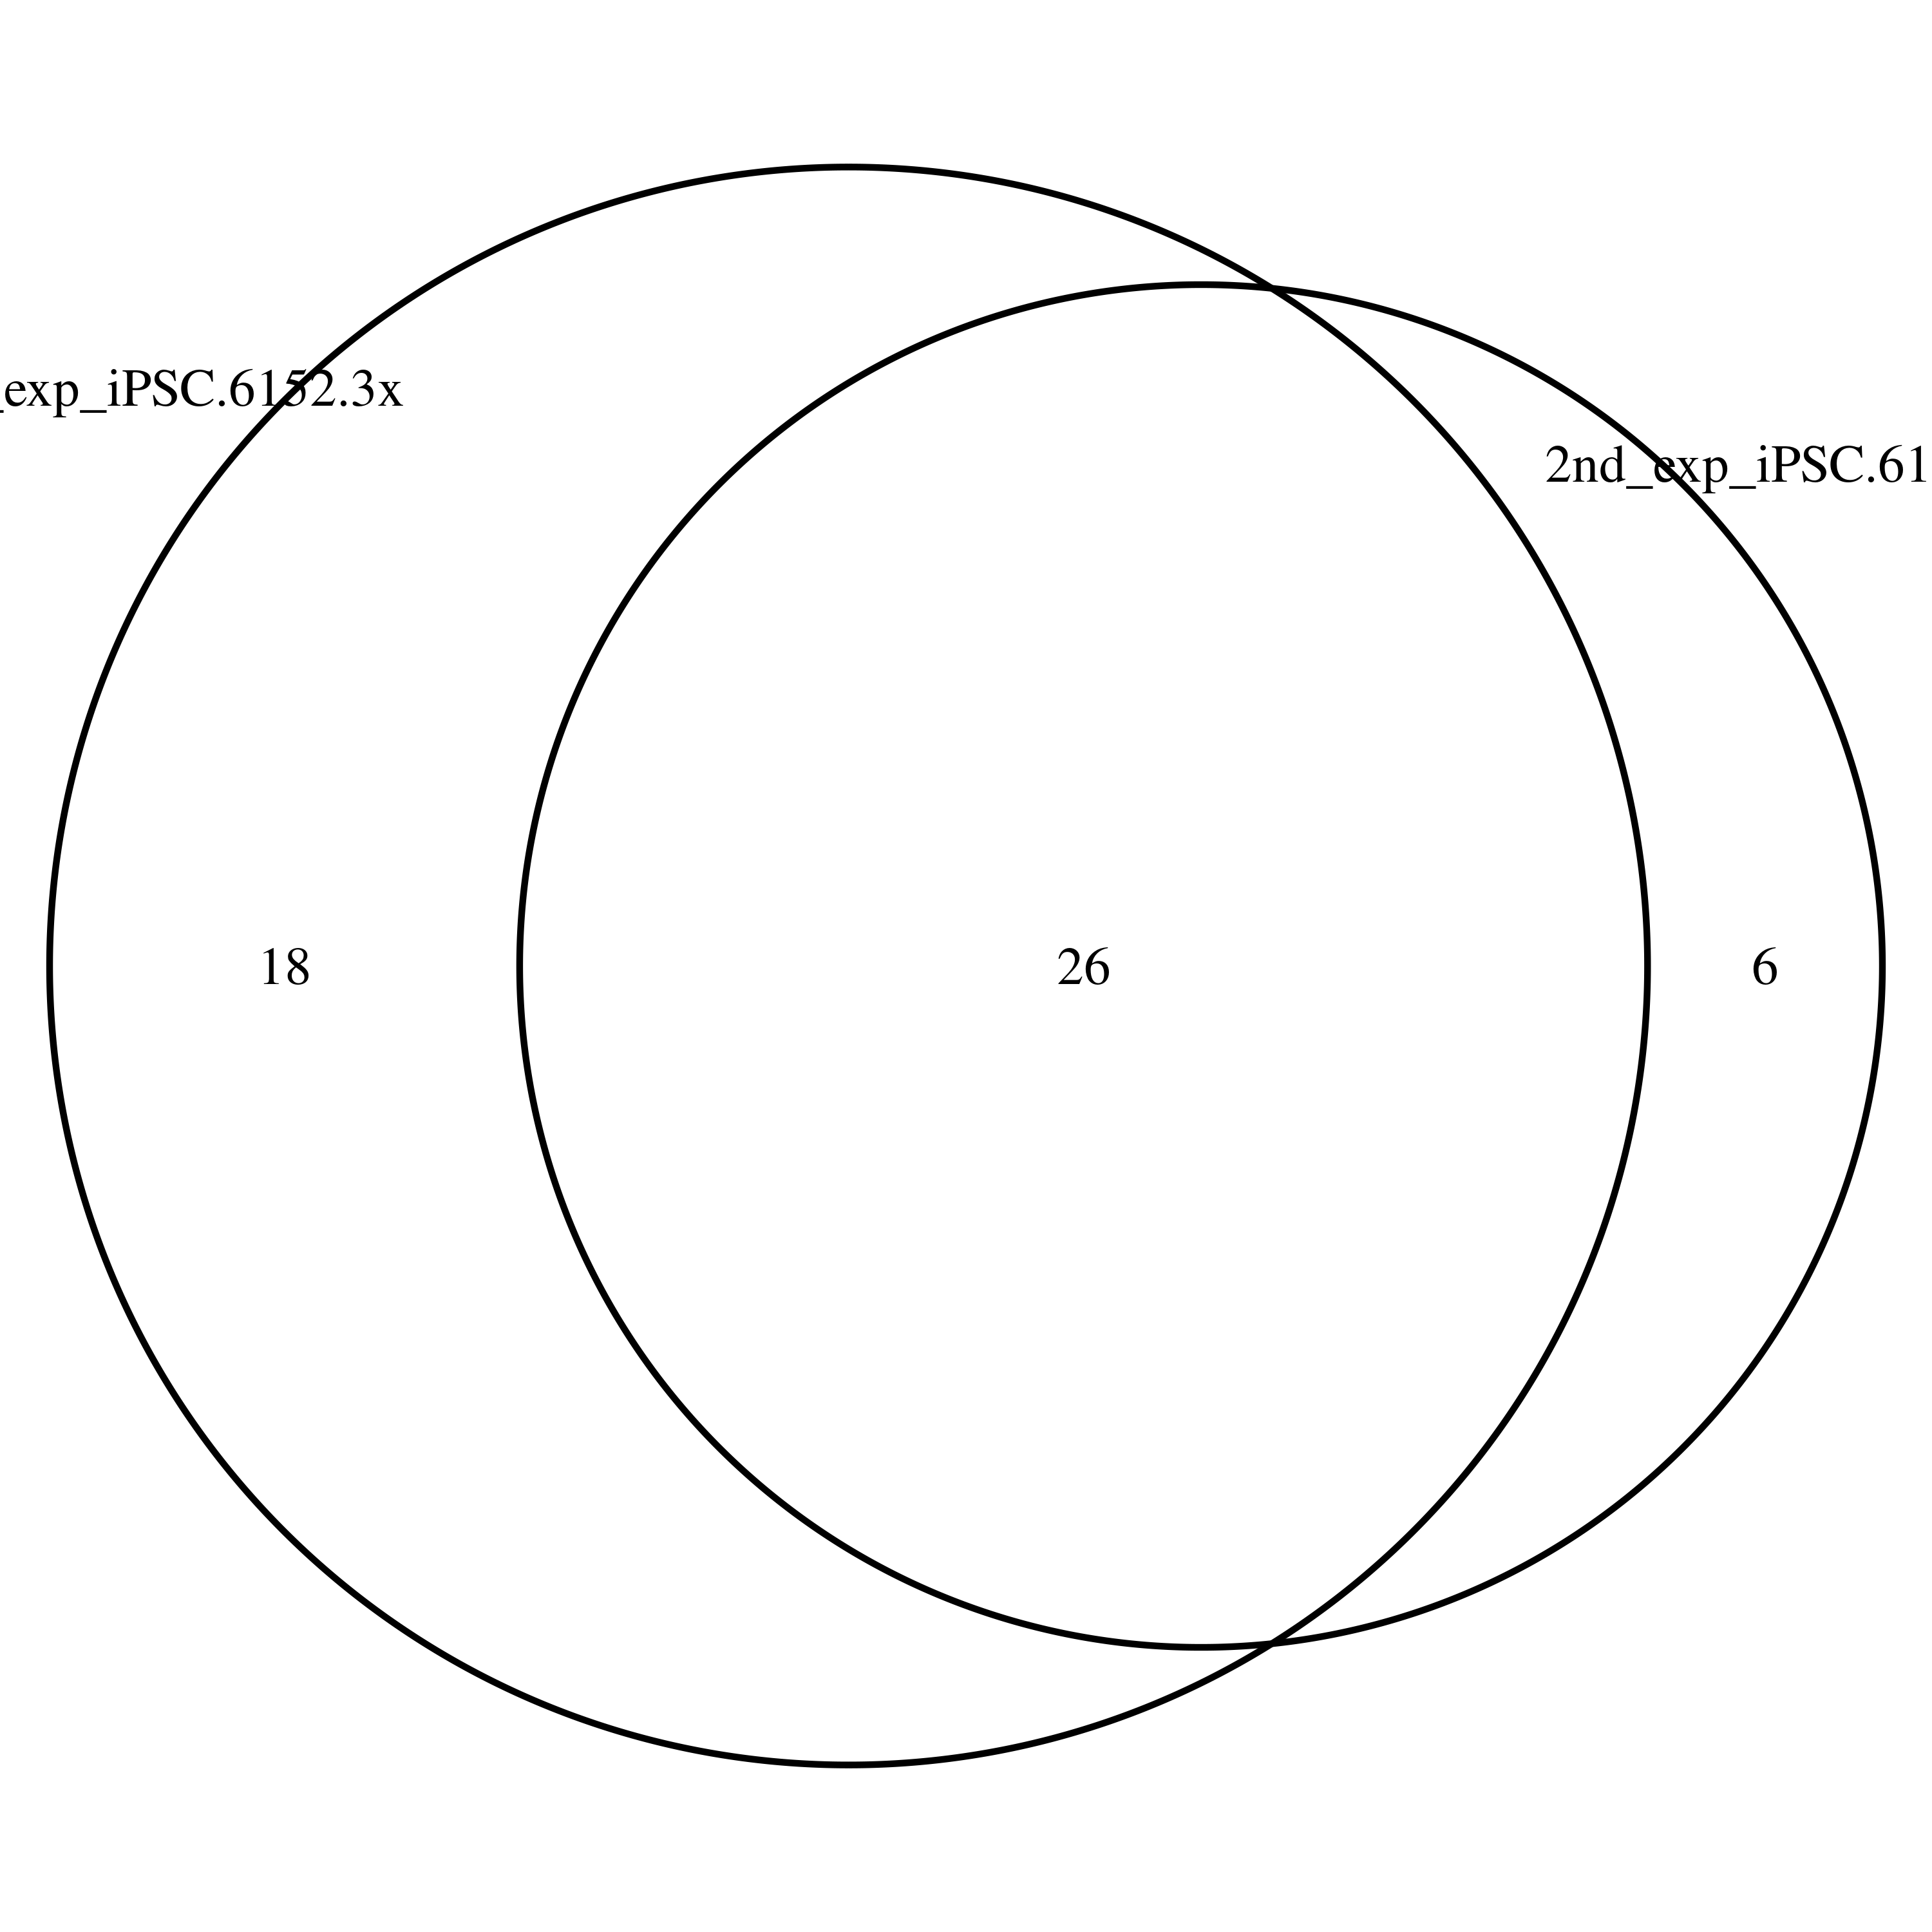
DSG repeatability among 1st and 2nd experiments is good

Slide 11
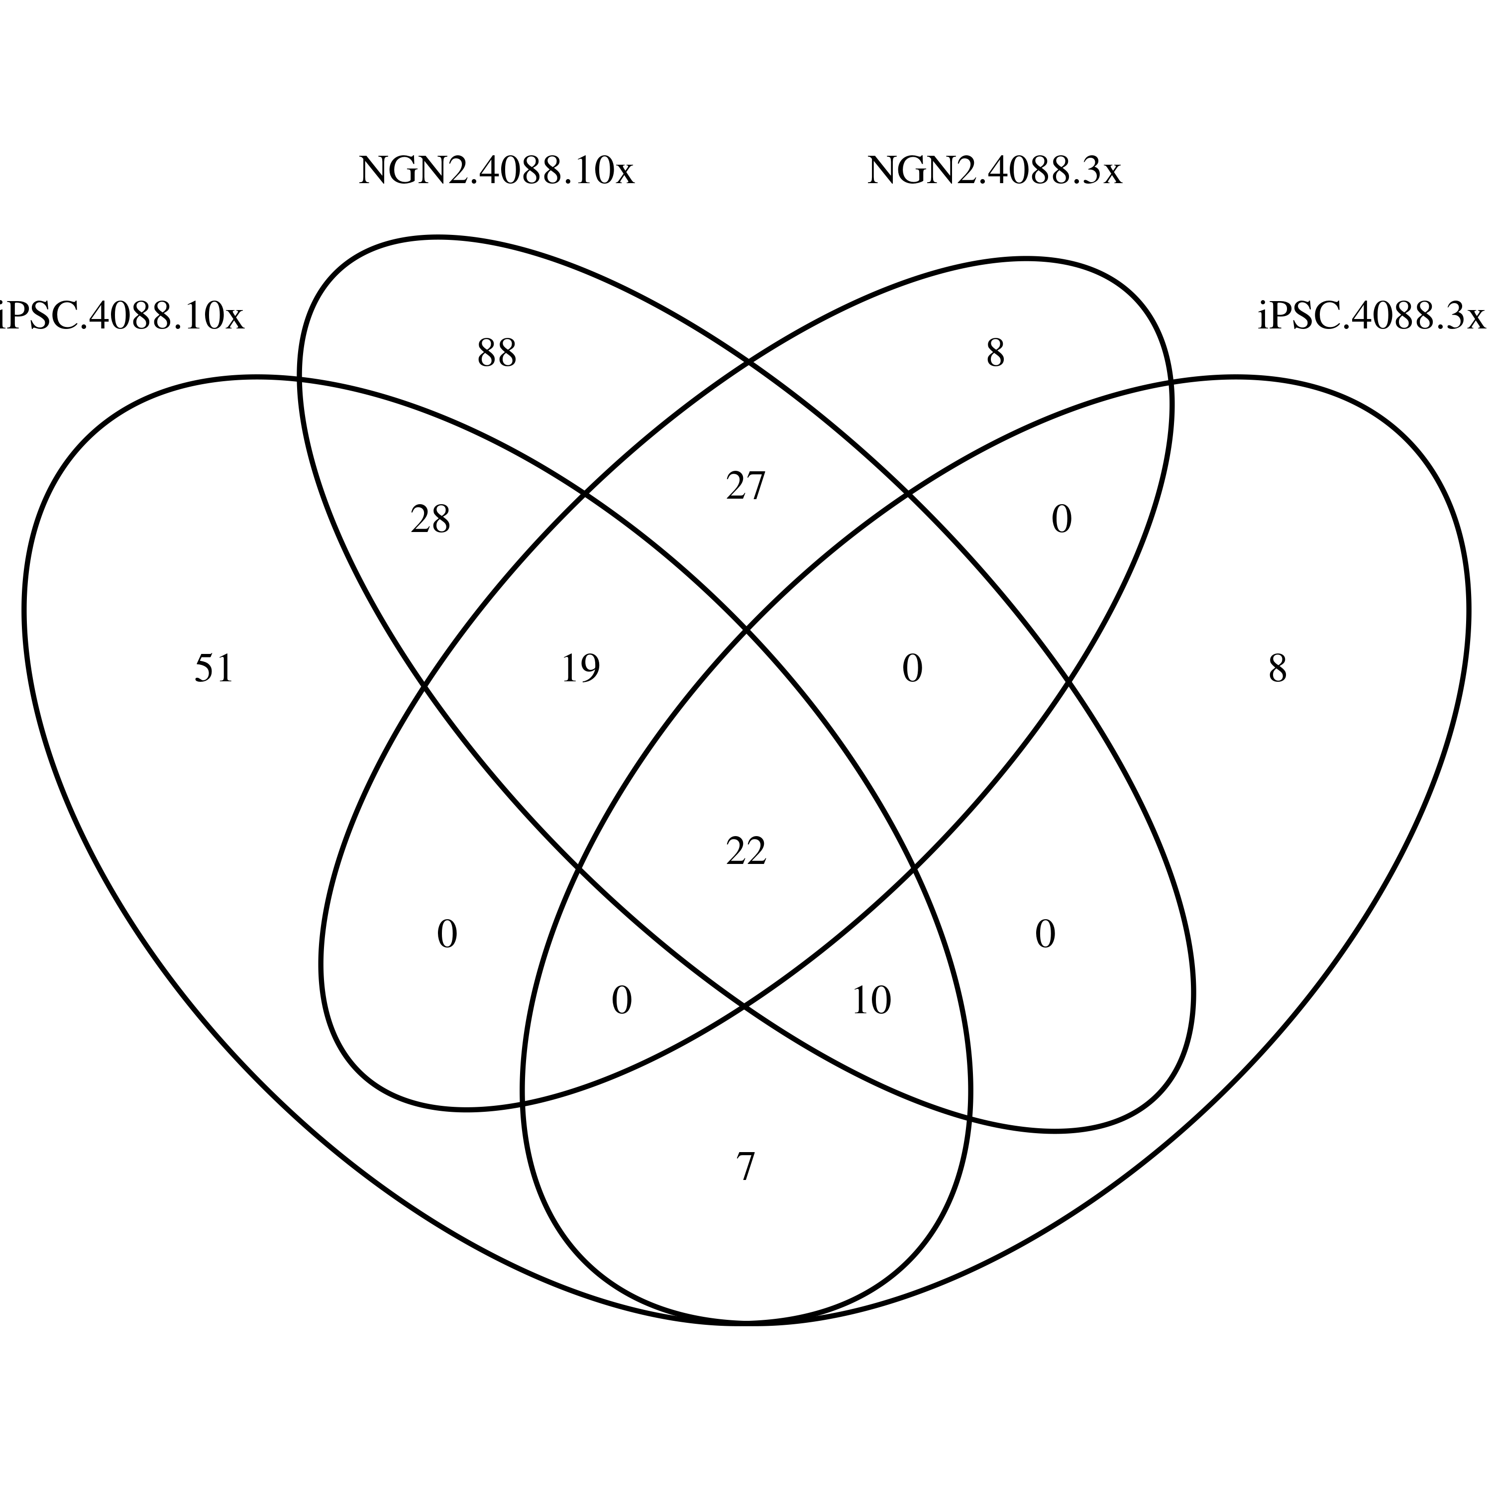
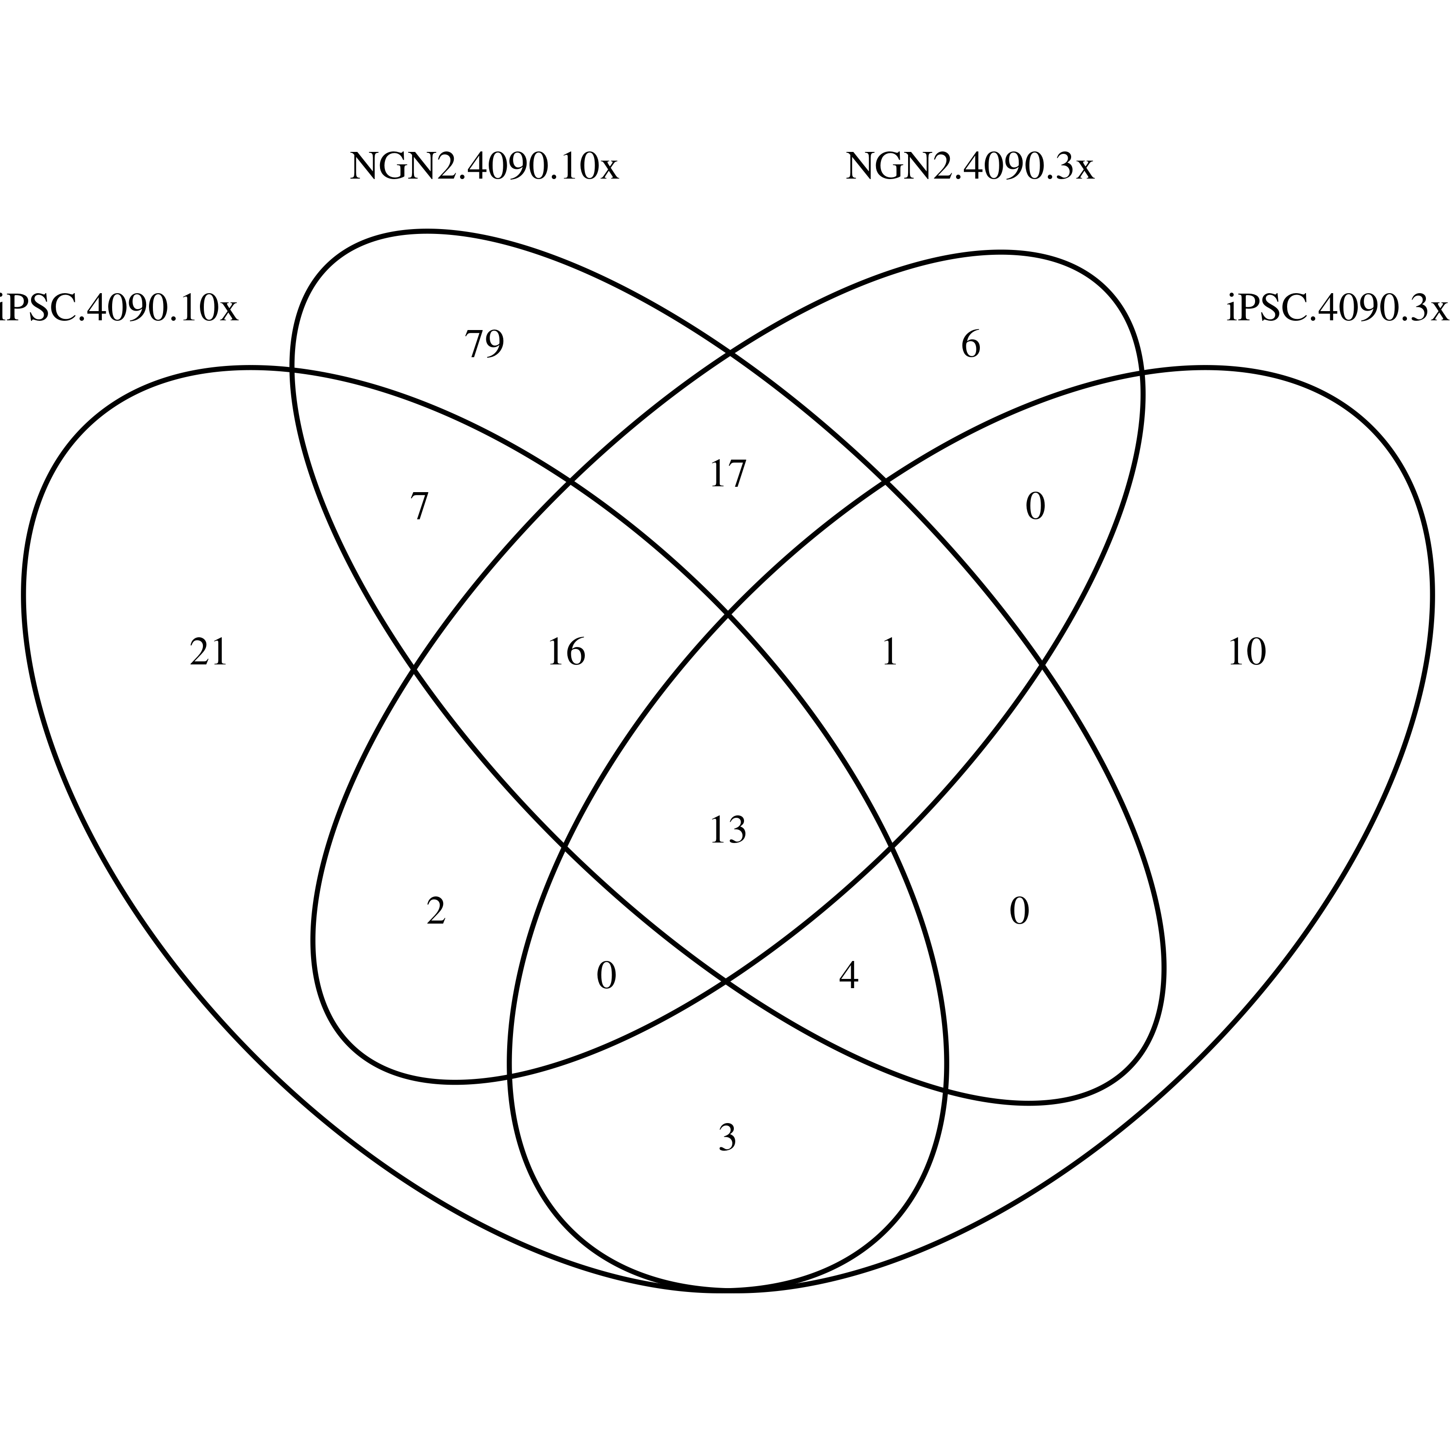
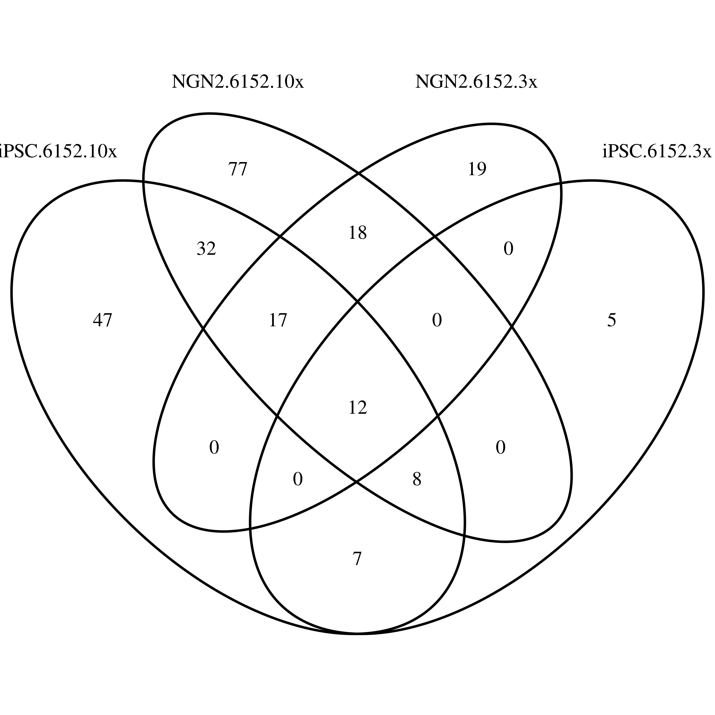
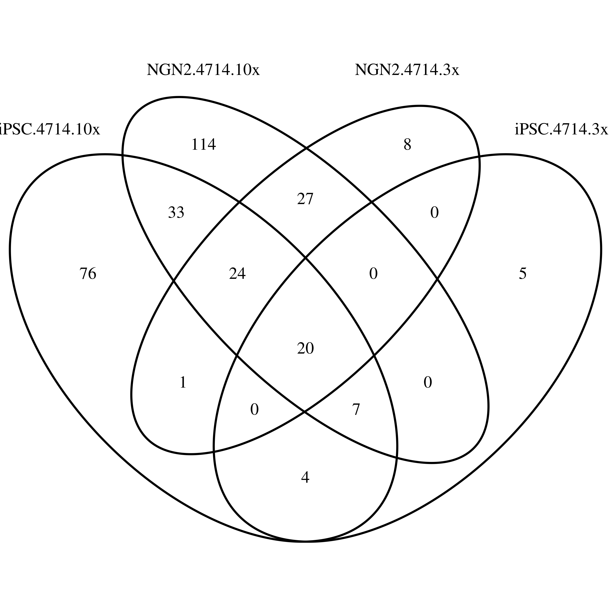
Most DSG induced by low concentration compounds were captured by high concentration ones

Slide 12
DSG repeatability among 1st and 2nd experiments is good

Slide 13
Sample similarity from Gene Expression
Expression heatmap for iPSC
Expression heatmap for NGN2

